Slide 1

Learning county from pixels:
Corn yield prediction with attention-weighted
multiple instance learning
Xiaoyu Wang
Advisor: Dr. Zhou Zhang
04/24/2024
Notes:
Hi everyone, I'm Xiaoyu Wang, a second year phd student advised by Dr Zhou Zhang. Today I'll present our work, learning county from pixels, corn yield prediction with attention-weighted multiple instance learning

Slide 2

Outline
Yield prediction: motivation, background, and method
Overview of our task
"Mixed pixel" problem
How to solve the "mixed pixel" problem
Experiment result
Attention analysis
Notes:
In the first section, we'll talk about yield prediction, the motivation, background and method

Slide 3

Motivation: hunger and food shortage
In the Sustainable Development Goals, zero hunger is ranked second.
795 million people still live without an adequate food supply.
By 2050, there will be two billion more people to feed.
Notes:
The motivation of yield prediction is hunger and food shortage. This figure shows the 17 sustainable development goals, we can see the zero hunger is ranked second. And there are two statistics. First, 795 million people still live without an adequate food supply. And second, By 2050, there will be two billion more people to feed. So the hunger is one of the most important issue in the world.

Slide 4
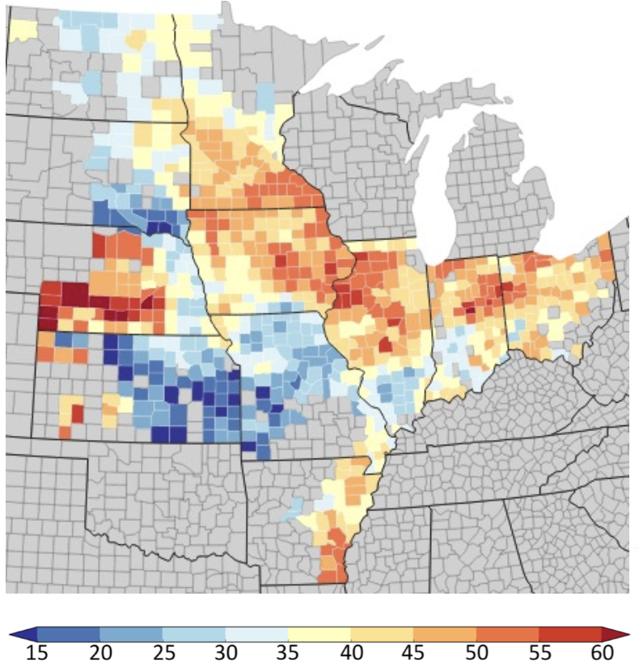

The power of yield prediction
Yield prediction can help with many problems:
Where to send food aid?
How much crop can we produce this year?
…
Planting decision
Food reserve
Risk management
Crop yield map in the U.S.
Notes:
now we'll introduce how yield prediction can help with hunger? What's the advantage of doing it? So yield prediction can help us solve many problems: for example, where to send food aid? How much crop can we produce this year? And it can help the farmers with the planting decision, food reserve, and risk management.

Slide 5
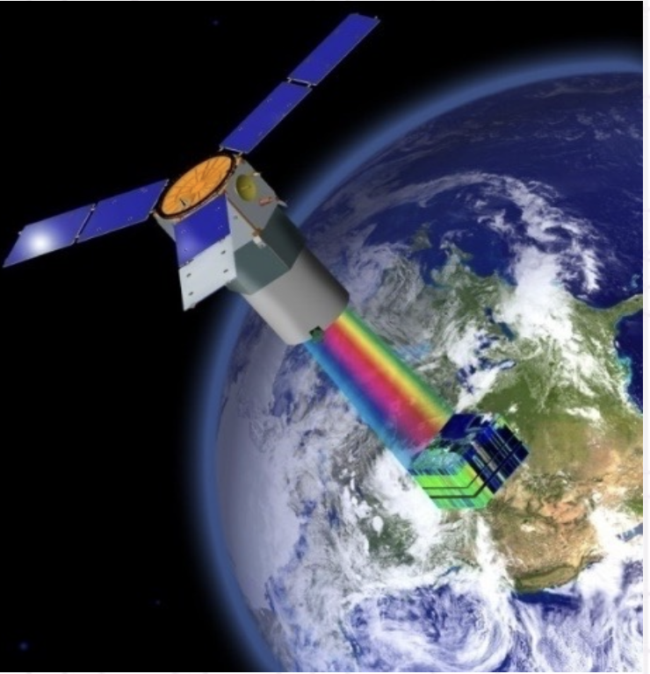
From yield prediction to remote sensing
Traditional method: often rely on time-consuming physical sampling and may lack precision due to the limited scope of ground surveys.
Remote sensing method: allows for comprehensive and frequent monitoring of crop health over many areas, providing high-resolution data that feed into more accurate and up-to-date predictive models.
Informative
Globally available
Inexpensive
Remote sensing image from satellite
Notes:
So we already know yield prediction is important, how can we do the yield prediction. In the traditional method, it often rely on time consuming physical sampling. And the manual survey may lack precision due to the limited scope.
here we turn to use remote sensing technique to do the yield prediction task. we collect satellite imagery from space, analyze these images, and predict the crop yield. The advantage of remote sensing method is informative, globally available, and inexpensive.

Slide 6
Outline
Yield prediction: motivation, background, and method
Overview of our task
"Mixed pixel" problem
How to solve the "mixed pixel" problem
Experiment result
Attention analysis
Notes:
In the next section, we'll have an overview of our yield prediction task

Slide 7
Overview of our task
Task: County-level corn yield prediction
Study area: U.S. corn belt
Study year: 2018-2022
Remote sensing features: satellite imagery of each county in the U.S.
Other features: precipitation, temperature, soil …
Method: Machine learning
Notes:
We focus on the county-level corn yield prediction. The study area is the us corn belt. And the study year is from 2018 to 2022. The remote sensing features we use is the satellite imagery. And we also use some other features like precipitation, soil and temperature. Our prediction method is machine learning.

Slide 8
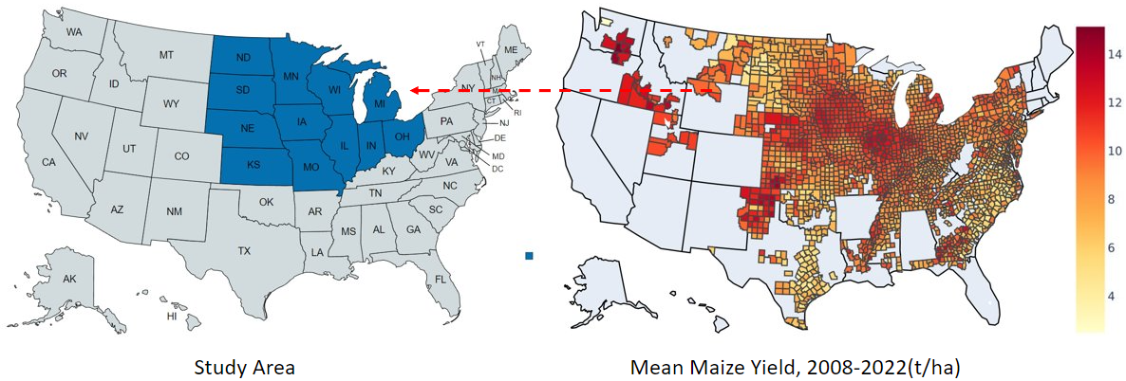
Study area
12 states in the U.S. corn belt: North Dakota, South Dakota, Minnesota, Wisconsin, Iowa, Illinois, Indiana, Ohio, Missouri, Kansas, Nebraska and Michigan.
Notes:
Let's have a look at the study area. the right figure shows the average corn yield in the us. So we choose to study these 12 states in the us corn belt, because they have the most corn yield.

Slide 9
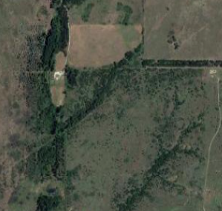
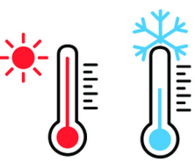

Diverse data sources powering yield prediction
The integration of satellite imagery and ancillary features into machine learning models.
+
Other agricultural features
Satellite imagery
Corn yield map
...
Temperature
Precipitation
Notes:
And this is the data we use. First we have the remote sensing imagery, together with some other features like temperature and precipitation. And our task is to get a corn yield map like this from these data.

Slide 10
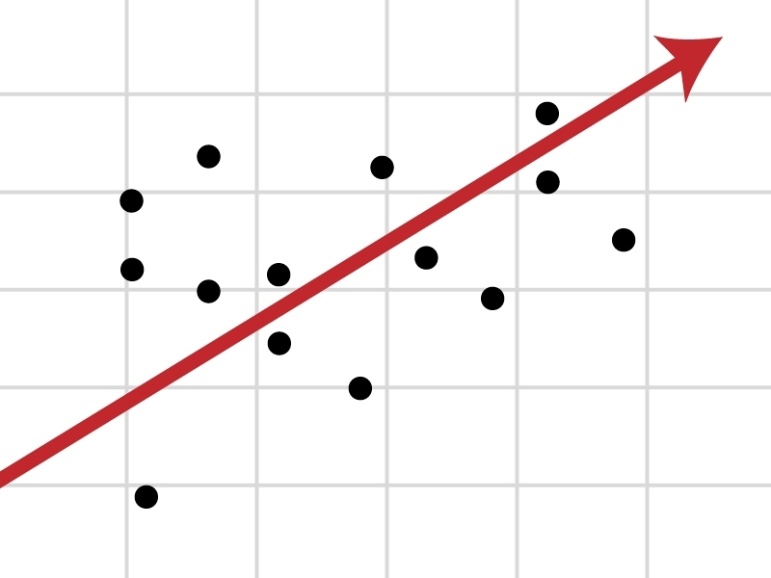
Machine learning model
Machine learning is a function, which maps an "instance" to its "label".
Label = Function (instance)
In our task, the function is: County yield = Function (county features)
It can learn patterns from big data and make accurate decisions.
In the figure, one point has a pair of property (county, yield), and the arrowed line is the learned machine learning model.
County yield
(Label)
County features
(Instance)
Notes:
So now let's turn to our method. First we will introduce, what is machine learning? In a word, machine learning is a function, which can map an instance to a label. So it's label equals function of instance. In our task it'll be county yield equals function of county features. So machine learning is a statistical function learned from big data. For example, in this figure, we have many data points, the x axis is the county features, and the y axis is the county yield. we use these points to fit an arrowed line. This arrowed line is the machine learning model we want.

Slide 11
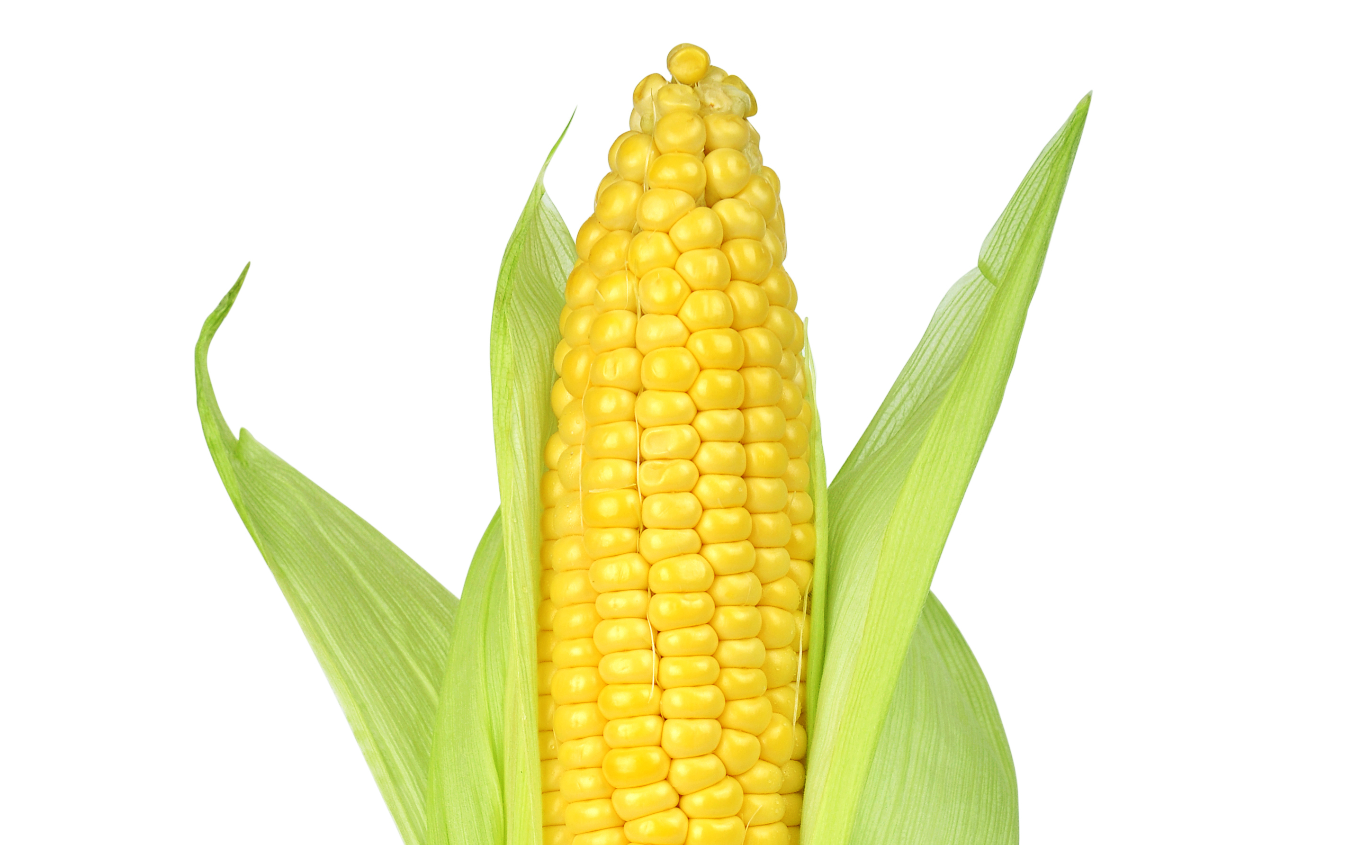
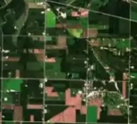
Multiple instance learning: better use pixel's information
Traditional machine learning: use the whole information in a county.
One instance corresponds to one label.
In our scenario, we treat one county as one "instance".
Multiple instance learning: use every pixel's information in a county.
One "bag" has many instances, and one bag corresponds to one label.
In our scenario, we treat one county as a "bag" and the pixels in this county as "instance".
model
yield = Function (county)​
County
Yield
model
yield = Function (pixel 1, pixel 2, ...)​
Pixels in County
Yield
Notes:
In this work we use multiple instance learning, which is one kind of machine learning. We just know, in the traditional machine learning, one instance corresponds to one label. In our yield prediction task, the county is the instance, and the yield is the label. We try to get yield equals function of county.
But now, instead of regarding every county as one instance, we try to split the county, and use every pixel's information in one county. So we use the multiple instance learning. In multiple instance learning, one bag has many instances, and one bag corresponds to one label. In our task, we treat the county as a bag, and all the pixels in this county as instances. Then our goal is to learn a model, yield equals function of pixel1, pixel2, ellipsis.
So the advantage of using multiple instance learning is, we can use every pixel's information in a county, instead of just using every county's information.

Slide 12
Outline
Yield prediction: motivation, background, and method
Overview of our task
"Mixed pixel" problem
How to solve the "mixed pixel" problem
Experiment result
Attention analysis
Notes:
In the next section we'll talk about the mixed pixel problem in our task

Slide 13
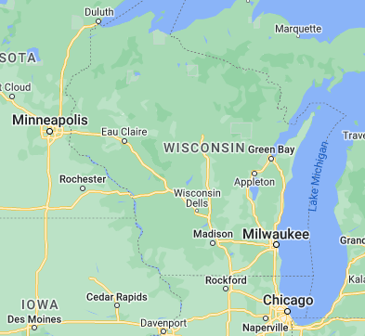
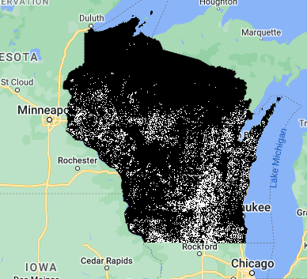
Identify the areas planted with corn
How do we determine which areas in Wisconsin are planted with corn?
Use a CDL crop mask to obtain the cornfields in the area.
In the right figure, white area is cornfield, black area is other land types.
The map of Wisconsin
The cornfield mask of Wisconsin
Notes:
First we'll introduce how can we determine the corn field in the map. In the left figure, this is the wisconsin state, and where is the corn field we want to study? So the solution is we can use a crop mask to get the corn field area in the map. The crop mask is public information on the internet. We can see in the right figure, after we apply the crop mask, the white area is the corn field we want to study.

Slide 14
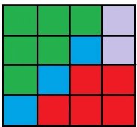
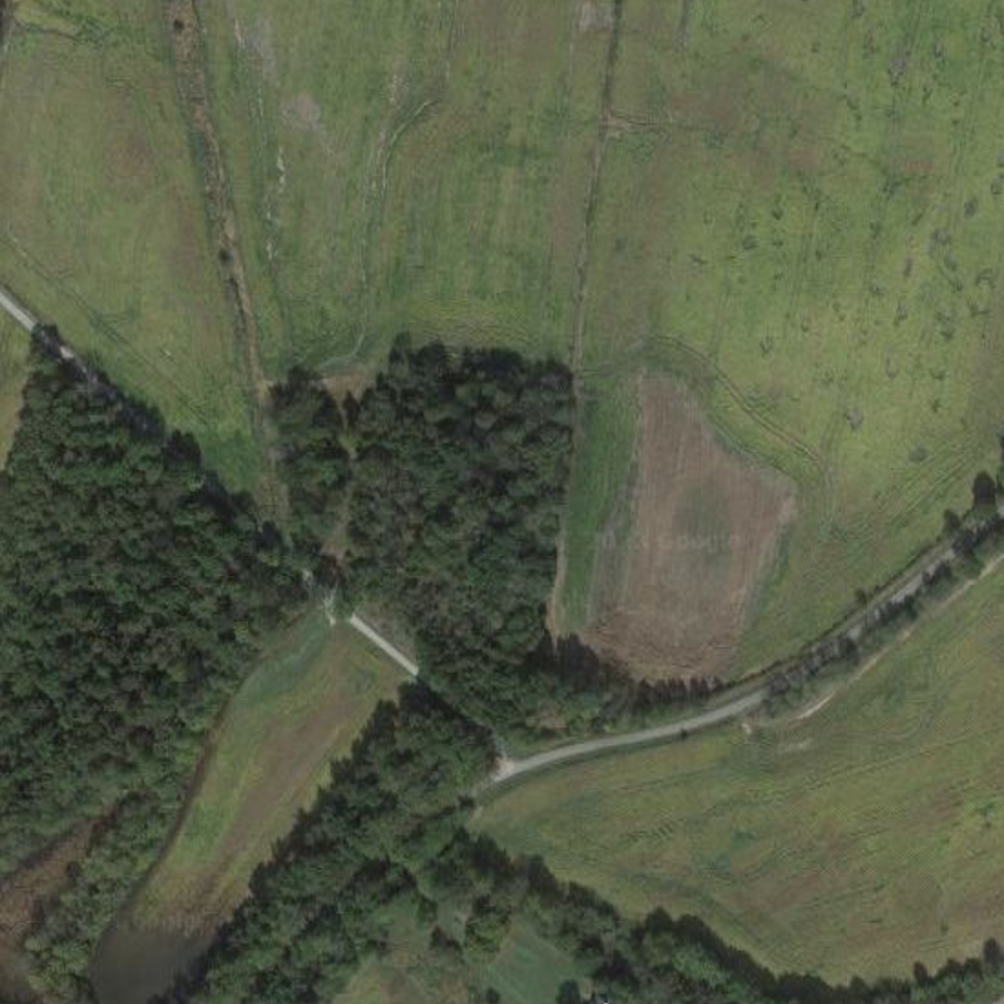
Zoomed-in satellite imagery dataset
Satellite imagery dataset: MODIS dataset.
Every remote sensing image in a big area is composed of many pixels,
and each pixel is a small piece of land.
MODIS image of a big area
Zoomed-in image of a part of this area
Each pixel is a small land
Notes:
to describe the mixed pixel problem, we need to zoom in the satellite imagery. We can see in the left figure, this is a satellite image of a big area. And now we zoom in to see a small part of this image, so we can imagine, there will be a lot of pixels in this small part. And every small pixel is actually a small piece of land.

Slide 15
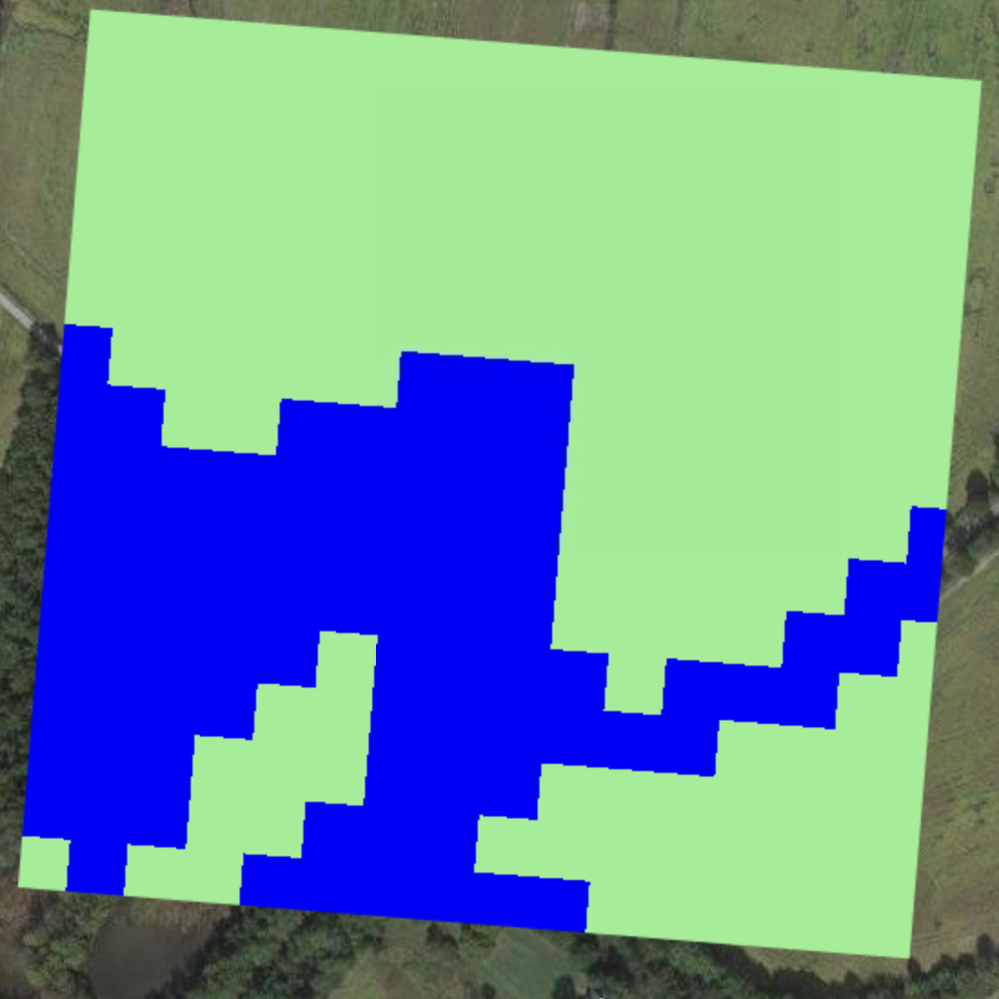
Mixed pixel problem
In the left figure, it shows a big pixel in MODIS dataset.
In the right figure, we use crop mask to identify the cornfield in this MODIS pixel.
The green portion is cornfield, the blue is forest.
The mixed information in the pixel will introduce noise into our model.
The small green cornfield pixels are what we want to study
The whole piece of land is a zoomed-in MODIS pixel
The big MODIS pixel masked by some smaller crop mask pixels
Notes:
So what is the mixed pixel? We can see the left figure, imaging this is just a pixel. But after we apply the crop mask to this pixel, we will find a part of this pixel is not cornfield. There will be some forests or bare soil. So we call this kind of pixels mixed pixel. the mixed information in the mixed pixel will introduce noise into our model. That is the problem.

Slide 16
Outline
Yield prediction: motivation, background, and method
Overview of our task
"Mixed pixel" problem
How to solve the "mixed pixel" problem
Experiment result
Attention analysis
Notes:
In the next section, we will talk about how to solve the mixed pixel problem.

Slide 17
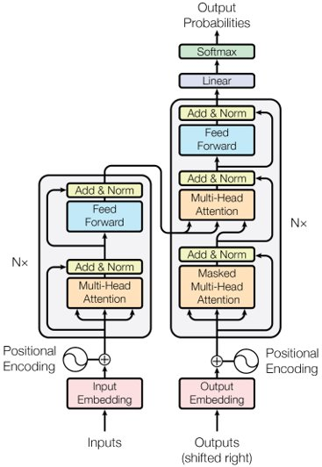

Transformer
Transformer: the state-of-the-art machine learning model.
ChatGPT
GitHub copilot
Sorry, not this ❌
Yes, it is ✔
Notes:
First we will introduce the transformer, the transformer is the state of the art machine learning model. It's not this transformer, actually it looks like that. But we don’t need to know the detail of this model. I think we are familiar with some famous applications of transformer, like chatgpt. I guess many of you use it to do homework. And if you are a coder, maybe you are also familiar with the github copilot. So these applications' model backbone are both transformer.

Slide 18

Attention module in Transformer
Attention is the most important module in Transformer.
The attention mechanism functions similarly to how humans focus on specific parts of their environment.
When you are in a classroom, you need to assign more "weight" to the teacher.
Attention!
A classroom
Notes:
And we'll describe how the transformer works. The most important module in transformer is attention. The attention mechanism functions like human focus on some parts of environment. For example, now we are in the classroom, so most of your attention will be focusing on me, which means, you assign more weights of your attention to me. So the attention in transformer is used to weight.

Slide 19
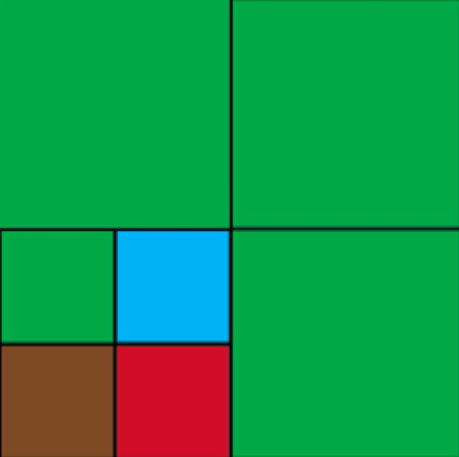
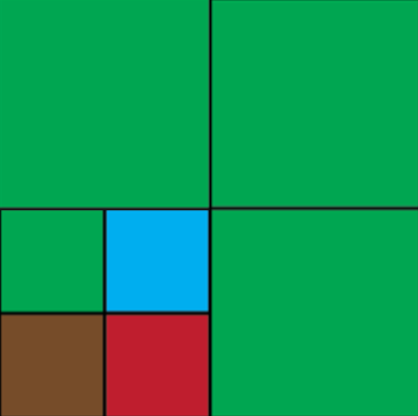
Apply attention to "mixed pixel" problem
We want to assign different weights to different types of pixels with attention module.
Pure pixels with higher weights.
Mixed pixels with lower weights.
Pure pixel
Pure pixel with higher weight
1
1
0.25
Mixed pixel with lower weight
1
Mixed pixel
An image with four pixels,
one of them is "mixed pixel",
other three are pure pixel
Assign different weights to different pixels
Notes:
So how can we use the attention mechanism to solve our mixed pixel problem? In the left figure, this is an image with four pixels, three are pure pixels, and one is mixed pixel. The green part is cornfield, and the other colors are other types of land. Now we use attention to weight this image. In the right figure, we can see for the pure pixels we can get the 100% weight, which is 1. and for the mixed pixel, ideally we can only get 25% weight. By this way, we can filter out the noisy information in the mixed pixels. And solve the mixed pixel problem.

Slide 20
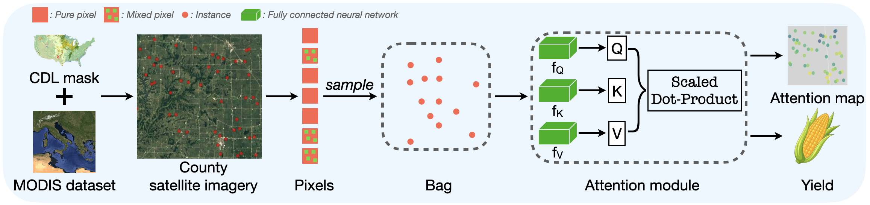
Pipeline of our implementation
Key contribution:
Use multiple instance learning to model the task, making use of the pixel-level information.
Use attention to assign weights to different pixels and filter out the noisy information in mixed pixels.
Notes:
And this is the pipeline of our implementation. First we have a satellite imagery dataset, then use the cdl crop mask to get the cornfield we want to study. Then in each county, we sample many pixels to use the pixel-level information. Then we use the attention module to filter out the mixed pixels' noisy information. Finally we make the yield prediction of this county.

Slide 21
Outline
Yield prediction: motivation, background, and method
Overview of our task
"Mixed pixel" problem
How to solve the "mixed pixel" problem
Experiment result
Attention analysis
Notes:
In the next section, we talk about the experiment result.

Slide 22
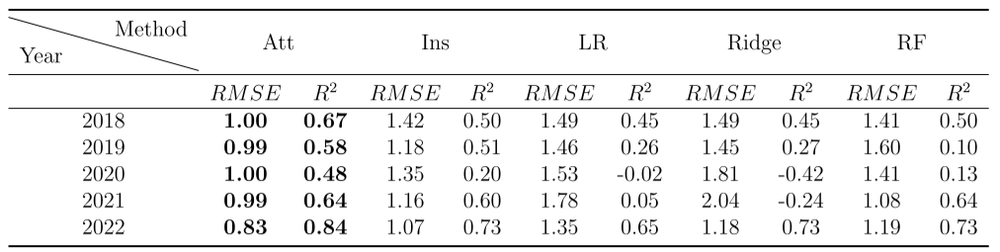
Yield prediction result
Our model: Attention-Multiple instance learning (Att).
Baseline model: linear regression (LR), ridge regression (Ridge), random forest (RF), Multiple instance learning (Ins).
The result shows our model is better than all the other models.
Model evaluation results in 2018-2022

Slide 23
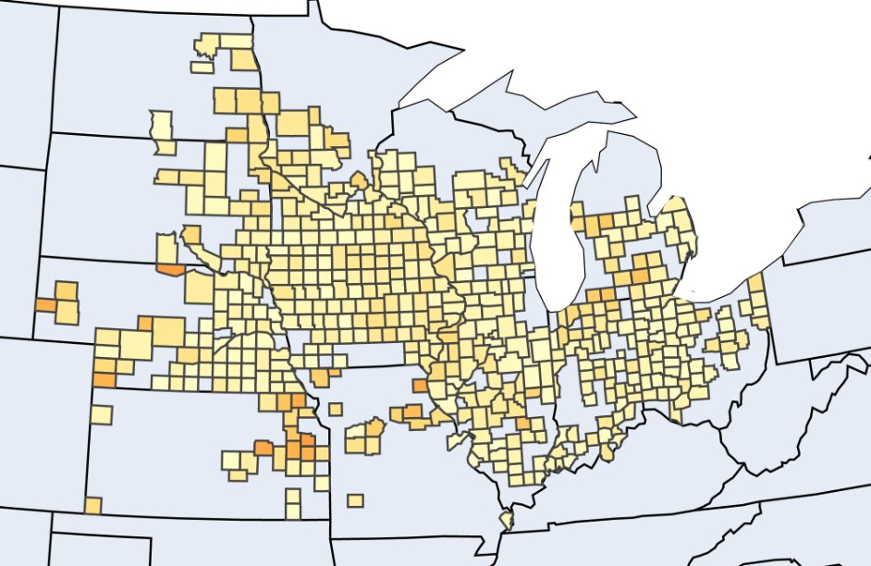
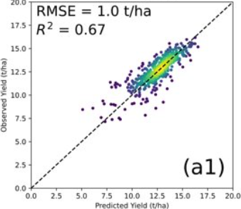
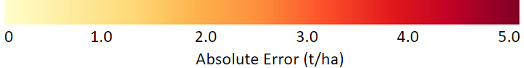
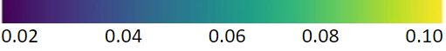
Results with figures
Absolute error map: Visually represents the discrepancies between predicted values and actual values, quantifying the error in absolute terms at each point or pixel.
Scatter plot: It uses dots to represent values for two different numeric variables.
Absolute error map
Scatter plot

Slide 24
Outline
Yield prediction: motivation, background, and method
Overview of our task
"Mixed pixel" problem
How to solve the "mixed pixel" problem
Experiment result
Attention analysis

Slide 25
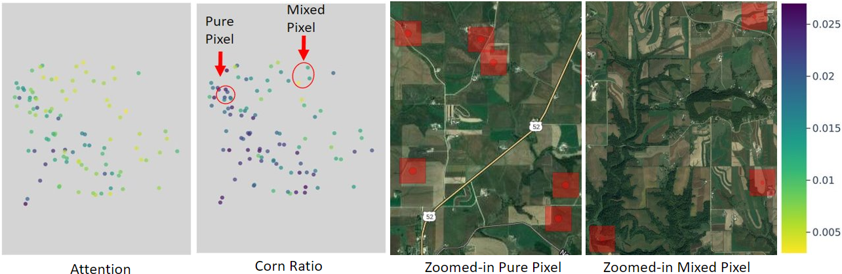
Attention map
Every point in the maps is one pixel.
Attention map: the darker the point, the more attention is.
Corn ratio map: the darker the point, the purer the pixel is.
We can see the zoomed-in pixels align with the attention map.

Slide 26
Conclusion
MIL is employed to leverage the pixel-level remote sensing observations.
To solve the mixed pixel problem caused by inconsistent resolutions of feature datasets and crop mask, an attention mechanism is incorporated to assign weights to pixels, thereby enhancing prediction accuracy.
Analyze the role of attention from both statistical and micro-perspectives, confirming the validity of our approach.

Slide 27
Thanks!

